Slide 1
Learning-Based Frequency Estimation Algorithms
Bigdatamining lab
Jongwoo Kim

Slide 2
Contents
Introduction
Algorithm
Experiments
Conclusion

Slide 3
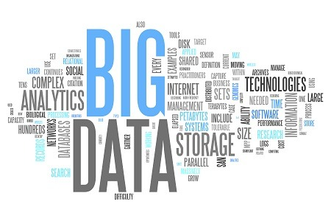
Introduction
Estimating the frequencies of elements in a data stream is a fundamental task in data analysis and machine learning.
However, in big data applications, the stream is too large (and may be infinite) and cannot be stored
This challenge has motivated the development of streaming algorithms, which compute a good estimate of the frequencies using a limited amount of space.
This problem is typically addressed using streaming algorithms which can process very large data using limited storage.
Using hashing-based algorithms : Count min ,count sketch … hashing function we already know.
Hashing based algorithms hash data items in to B buckets, count the number of items hashed in to each bucket, and use the bucket value as an estimate of item frequency.
Notes:
Estimating the frequencies of elements in a data stream is a fundamental task in data analysis and machine learning.
This problem is typically addressed using streaming algorithms which can process very large data using limited storage.

Slide 4

What is streaming data?
Streaming data is generated continuously by thousands or millions of data sources.
Internet traffic data
Search queries
log files
Notes:
The goal of Frequency Estimation is ,to count ,the number of times an item, appears in the data stream.

Slide 5
Introduction
Frequency Estimation is to count the number of times an item appears in the stream.
Which internet links have the most traffic?
Which search phrases are trending now?
What are the trending topics on the social network?
Notes:
1. The goal of Frequency Estimation is, to count, the number of times an item, appears in the data stream.
2. In the real world, many people want answers to these questions.
3. However in the big data application, the stream is too large and cannot be stored.

Slide 6
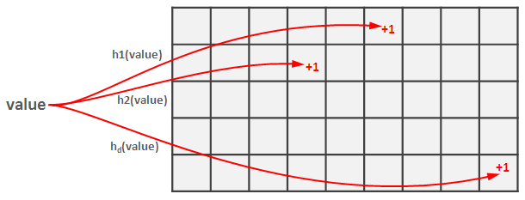
Introduction
But the stream is too large(and may be infinite) and cannot be stored.
Therefore, frequency estimation algorithms was made to compute a good estimation using a limited amount of space.
e.g.) Count-min, Count-sketch ...
<Hash table>
Notes:
However in the big data application, the stream is too large and cannot be stored.
1. This challenge has motivated the development of streaming algorithms.(which compute a good estimate of the frequencies using a limited amount of space)
2. Therefore, frequency estimation algorithms was made to compute a good estimation using a limited amount of space.
3. Such as count-min , count sketch,
these algorithms, we have already studied in quiz.

Slide 7
Problem
‘Collision’ : When two elements are mapped to the same bucket, they affect each others estimates.
Hashing based algorithm can not avoid collisions between words in a limited space.
word
<collision (same hash value)>
‘Heavy hitter’ has a large impact on the estimation.
High frequency element called ‘Heavy hitter’
e.g.) of , the , a .. (in English)
Notes:
But there is some problem.
problem is collision.
Collision occurs when two elements are mapped to the same bucket ,
hashing based algorithm can not avoid collisions between words in a limited space.
If collision between small frequency element, it is a trivial things
However heavy hitter has a large impact on the estimation
‘Heavy hitter‘ means high frequency element
For example in English these words are heavy hitters

Slide 8
Learning-based algorithms
Collisions are unavoidable
To minimize estimation error, control heavy hitter well.
Proposed idea : Learn the heavy hitters property and assign heavy hitters their own buckets.
How to learn about heavy hitters property?
=> Deep learning.
Notes:
1. In hashing-based algorithms, collisions are unavoidable, ​
2. so heavy hitters must be handled well to minimize errors.​
3. For this reason , they proposed the learning based algorithms.​
​
4. Proposed idea learn the heavy hitters property and assign heavy hitters their own buckets.​
5. this paper uses deep learning to learn about the properties of heavy hitter.​

Slide 9
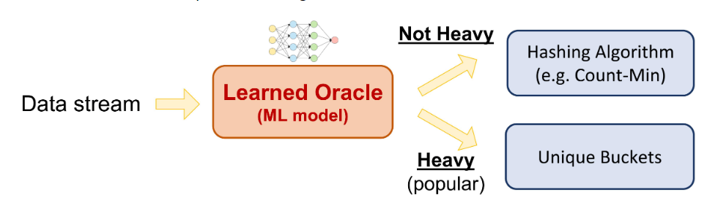
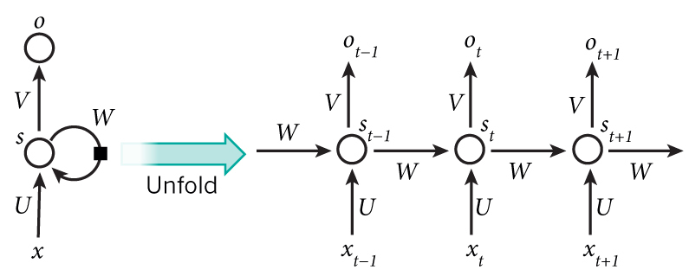
Algorithm
Consist of RNN
Learn data pattern
<RNN structure>
Notes:
1. Classical algorithms often fail to leverage useful patterns in their input
2. But Deep learning captures data patterns well.
3. So they use RNN to learn about the property of heavy hitters.
4. RNN is kind of deep learning model for capturing and learning data pattern.
5. Oracle is a learned classifier consist of these RNN and determines whether it is a heavy heater or not.
6. Let's look at the detailed algorithm

Slide 10
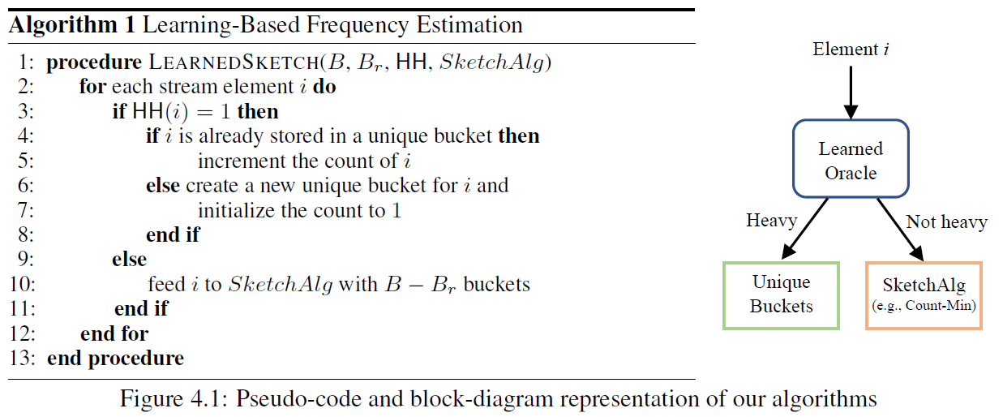
Algorithm
1
2
3
4
5
6
7
Reserve bucket
<Hash table>
Input
Assign unique bucket
Count-min , count-sketch ..
Notes:
1. Algorithms is very simple.
2. For each stream element I, if item I is heavy hitters then assigned to unique buckets reserved for heavy item.
3. Item I is not heavy item, then fed to the remaining bucket using a conventional frequency estimation algorithm.
4. In this process, oracle learned the properties of heavy items.
5. It is important that Oracle learns the properties that identify heavy hitters, as opposed to the identities of the heavy hitters themselves.
6. For example, in the case of word frequency, the oracle would learn that shorter words are more frequent, so that it can identify popular words even if they did not appear in the training set.
버켓: sum of hash value is address of bucke

Slide 11

Expected error
Estimation error : $e_{i}≔\left|\tilde{f_{i}}−f_{i}\right|$
$$Frequence :F=\{ f_{1}, f_{2}, ⋯,f_{\left|U\right|}\}$$
$$Estimation frequency: \tilde{F}=\{\tilde{f_{1}}\tilde{, f_{2}},⋯, \tilde{f_{|U|}}\}$$
For any j , ${Pr}_{i\sim D}\left[i=j\right]= \frac{f_{j}}{N} where N is the sum of all frequencies.$
$Err\left(F,\tilde{F}\right)≔\sum_{i∈U}{ \left|{\tilde{f}}_{i} −f_{i}\right|∙\frac{ f_{i}}{N}}$
Sum of estimation error
Probability of item i
Notes:
1. and then they define expected error,
2. The front equation is sum of estimation error,
3. behind part is probability of item I or ratio of item i
It just used to compute error in experiment part , but I think It maybe used to loss function.
D가 무엇임? :we assume Query distribution D is the same as the distribution of the input stream.
왜 이렇게 정의함? In this paper They just say believe that this equation is more natural from machine learning perspective.​

Slide 12
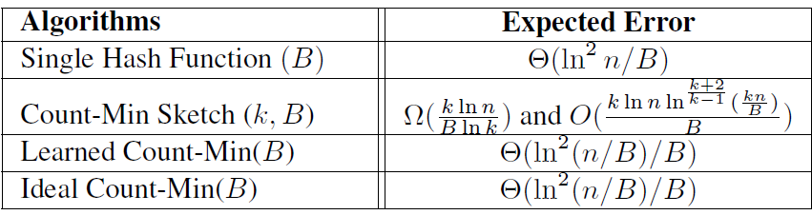
Expected error
Learned count-min : Oracle
Ideal Count-min : Already know the identities of the heavy hitter
If perfect oracle, error bound same
Notes:
And using the expected error they defined, if learned model is perfect, error is equal to the ideal model error bound.
This paper proved it mathematically and it's about ten pages long, so I'll skip the explanation.

Slide 13
First Experiment
Estimate the number of packets for each network flow.
Data set: Internet Traffic data Tier1 ISP between Chicago and Seattle in 2016(CAIDA)
30 million packets, 1 million unique packets (1 hour )
Input : IP addresses of source and destination, ports (each packet)
Training data : 7 minute
Test data : 53 minute
Notes:
first experiment is about internet traffic
the goal is to estimate the number of packets for each network flow.
A flow is a sequence of packets between two machines on the Internet
Data set is internet traffic data between Chicago and seattle
Input is ip-address and port
7 minutes were used to train the model and the rest 53 minutes were used for testing.

Slide 14
Estimate the number of packets for each network flow.
Input ( each packet )
RNN take one bit at each step
Source
IP address, port
RNN
FC-layer
Destination
IP address, port
RNN
FC-layer
Concat[ IP vector, port vectors ]
Notes:
1. they use two RNNs to encode the source and destination IP addresses separately.
2. RNN takes one bit of the IP address at each step
3. The feature vector encoded over the RNN and fully-connected layers comes out, then concatenate encoded IP vector and port vector.
4. this paper said just use this 'concat feature' to predict the packet counts.
5. They didn’t mention how to use it.
6. I think it is kind of encoder structure , this concat feature maybe input of decoder.
7. then decoder trained by concat feature, it used to inference whether input packet is a heavy hitter or not.
왜 RNN 씀?
In previous studies, RNN showed good performance.
And also in the Internet traffic data Bits are hierarchical, the more significant bits govern larger regions in the IP space.

Slide 15
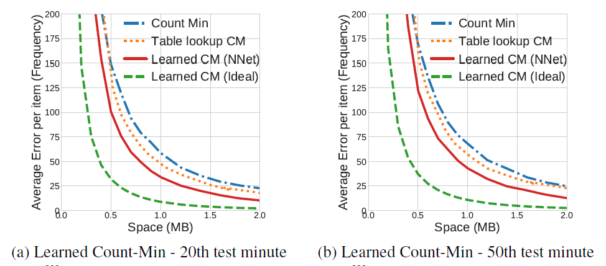
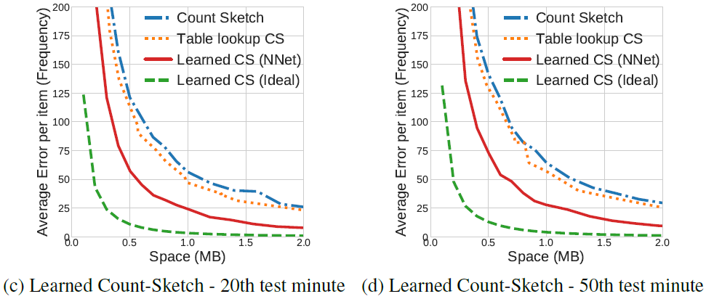
Estimate the number of packets for each network flow.
Oracle (red line) : learned count-min
Ideal (green dot line) : already know the identities of the heavy hitter in the test data
Table lookup CM (orange dot line) : memorizes heavy hitters in the training set
-Learned CM reduce the error 32%~42%.
-Learned CS reduce the error 52%~57%.
-Also oracle better performs better than lookup table.
Notes:
Red line is oracle, Green dot line is idel learn count min
2. Table look up CM is orange dot line, it just memorized heavy hitter in the training set.
3. Learned Count Min reduce about 32% error compare to normal count min.
4 .And oracle also better performance than table look up,
5. Because Internet traffic is very dynamic nature.
6. the heavy flows in the training set are significantly different from those in the test data .
7. so memorization does not work well.
8. So oracle is able to extract structures in the input that generalize to unseen test data.
(Therefore this model can learn the characteristics of the input and generalize to unseen test data.)
9. Also 20th, 50th minute almost same performance, It means their learns properties of the heavy items that generalize over time.
Significant improvement over CM, CS, also can potentially achieve even better results with an ideal oracle.
-> this indicates potential gains from further optimizing the neural network model.
But I think that is very hard.
학습 공간 : space includes space for storing the buckets and the model.
Each regular bucket takes 4 bytes.
Unique bucket takes 8bytes.

Slide 16
Second Experiment
Estimate the number of times a search query appears.
Data set: AOL query log dataset.
21million search queries , 650 thousand users , 90 days
Input : Search phrase
Training data : 5 days
Test data : 85 days
Input
characters of Search phrase
RNN
FC-layer
Encoded vector
Notes:
second experiment is estimate the number of times a search query appears.​
​
Data set consist of search query.​
​
First 5 days for training , and the following day for validation​
​
And it also They didn’t mention how to use it encoded vector.​
​
Just use this encoded to predict frequency.​
​
왜 구조가 다름?
I think it maybe because internet traffic data input is two-way, input are divided two part source and destination

Slide 17
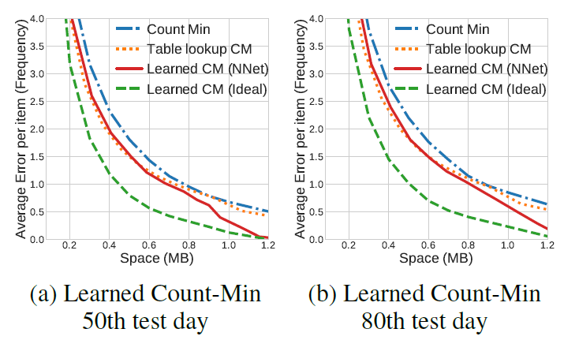
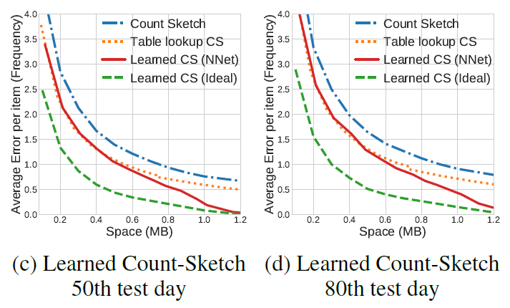
Estimate the number of times a search query appears
-Learned CM reduce the error 18%~52%.
-Learned CS reduce the error 24%~71%.
- Table lookup is quite effective in the low space region.
=>search queries are less dynamic compared to Internet traffic.(top queries in the training set are also popular on later days).
e.g.) google, weather,
Notes:
1. In this experiment ,oracle also better performance than normal count min algorithms
2. But table lookup is quite effective in the low space region
3. Because Search queries are less dynamic compared to Internet traffic.
4. Unlike traffic data, popular search queries tend to appear more consistently across multiple days.
5. For example, “google” is the most popular search phrase in most of the days in the dataset.
6. But allow more space, memorization becomes ineffective.

Slide 18
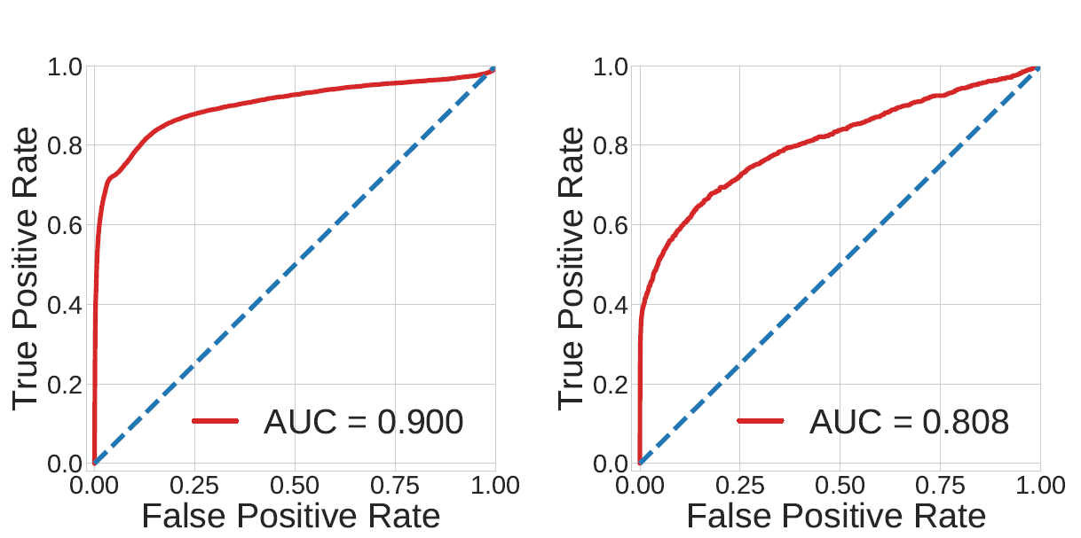
Analyze the accuracy
Internet traffic data AUC (Area Under Curve) score : 0.9
Search query data AUC score : 0.8
=> Model for Internet data has learned to predict heavy items more effectively.
<ROC curves of the Learned model>
Notes:
This part is analyze the accuracy of the neural network heavy hitter models.
Accuracy is evaluate with a roc curve.
AUC score of Internet traffic data is zero point 9
And search query score is 0.8
It means that oracle learns more about dynamic data.

Slide 19
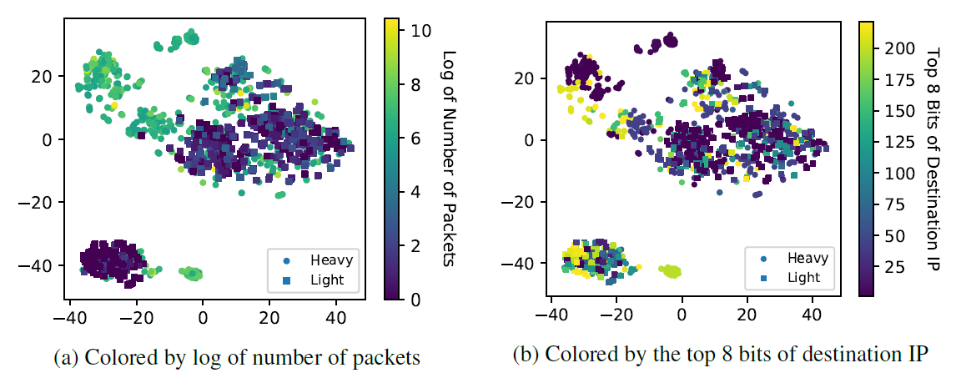
Analyzing internet traffic Data
Random sampling in heavy hitter & rest item(equal amount)
Each point : one Internet traffic flow
Large packet flow : green and yellow clusters
Small packet flow : blue clusters
=> Large packet clusters are often formed by similar destination address prefixes.
=> Learning this ‘structure’ , model can generalize to packets unseen in the training set.
IP address prefix: 1.96.*.*
Large packet clusters
<Embedding spaces learned by the Internet traffic data>
Destination IP address embedding space
Number of packet embedding space
Notes:
In this part , visualized to identify the characteristics that the model has learned
It takes neural network activation before the final FC layer, and visualize them in a 2-dimensional space.
This is Embedding space learned by the Internet traffic Data
To illustrate the difference between heavy hitter(top 1 % in counts) and the rest( light items), randomly sample an equal amount from both classes.
Left scatter plot show that number of packet. Right scatter plot show that destination IP address.
It scatter means Large packet clusters are often formed by similar destination address prefixes
So the model learns to group flows with similar IP prefixes closer in the embedding space.
And also Maybe model learns that company or school is more traffic

Slide 20
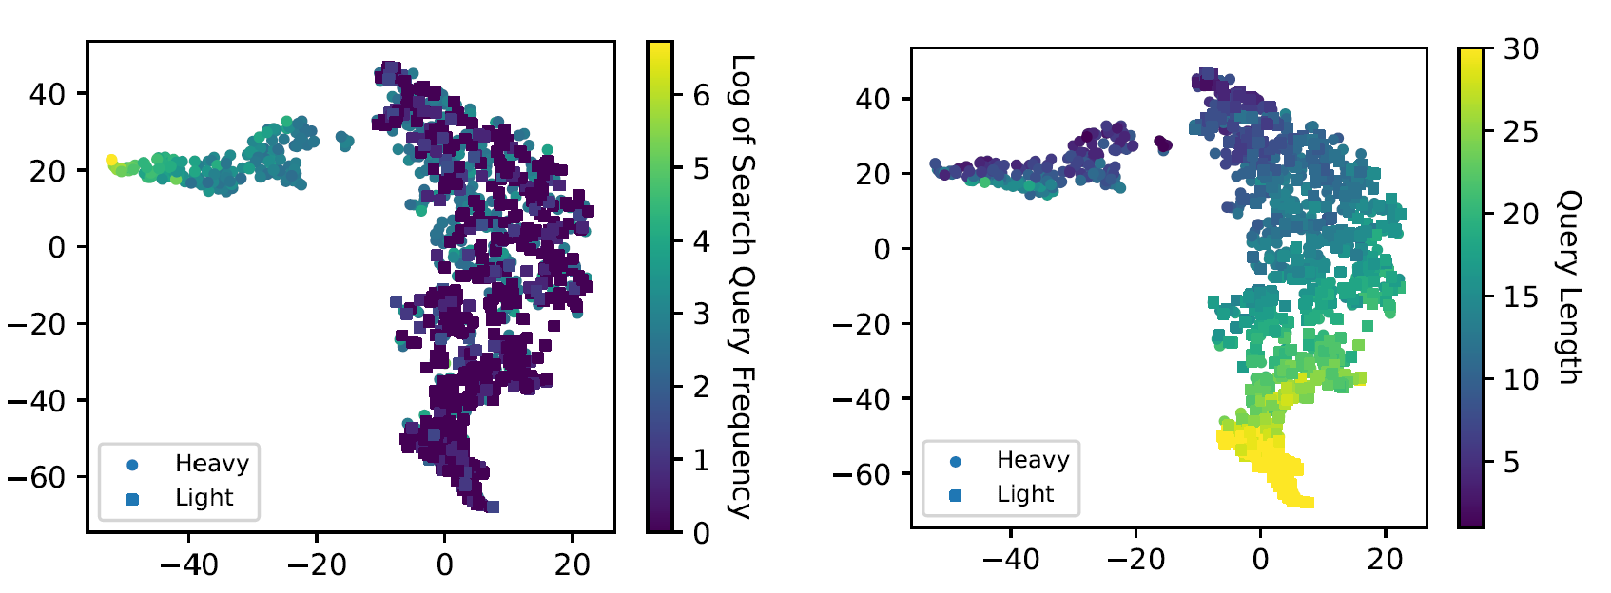
Analyzing search query data
Random sampling in heavy hitter & rest item(equal amount)
Each point : one search query
High frequency : green and yellow clusters
Low frequency : blue clusters
=> Similar length queries are closer each other.
=> If model use the query length to predict heavy hitters, light queries will be misclassified.
Query length and query frequency has less relation.
<Search query Frequency Embedding spaces>
<Query length Embedding spaces>
Notes:
Similarly, the model learns to separate frequent search queries
Left is query frequency , right scatter plot is query length.
In the red box, left scatter plot is
The frequency of the dots in the red box is similar.
However, the distribution of scatter plots about query length is very diverse.
It means that query length and query frequency has less relation.
if simply use the query length to predict heavy hitters, many light queries will be misclassified.

Slide 21
Conclusion
Presented a new approach for designing frequency estimation streaming algorithms.
Demonstrated the benefits of oracle both analytically and empirically.
Notes:
so it is conclusion this paper

Slide 22
Thank you
Notes:
This is end of my presentation

